Slide 1
LG Architecture Training Program
Project Technical Introduction
Dan Plakosh
Notes:
This is the slide title. The title of the lecture topic goes in:
<Lecture Title Here>
The lecturer should put their name in:
<Presenter’s Name Here>

Slide 2
Session Outline
Project Purpose and Expectations
Project Description
Overview the Automatic License Plate Recognition System
Project requirements and objectives

Slide 3
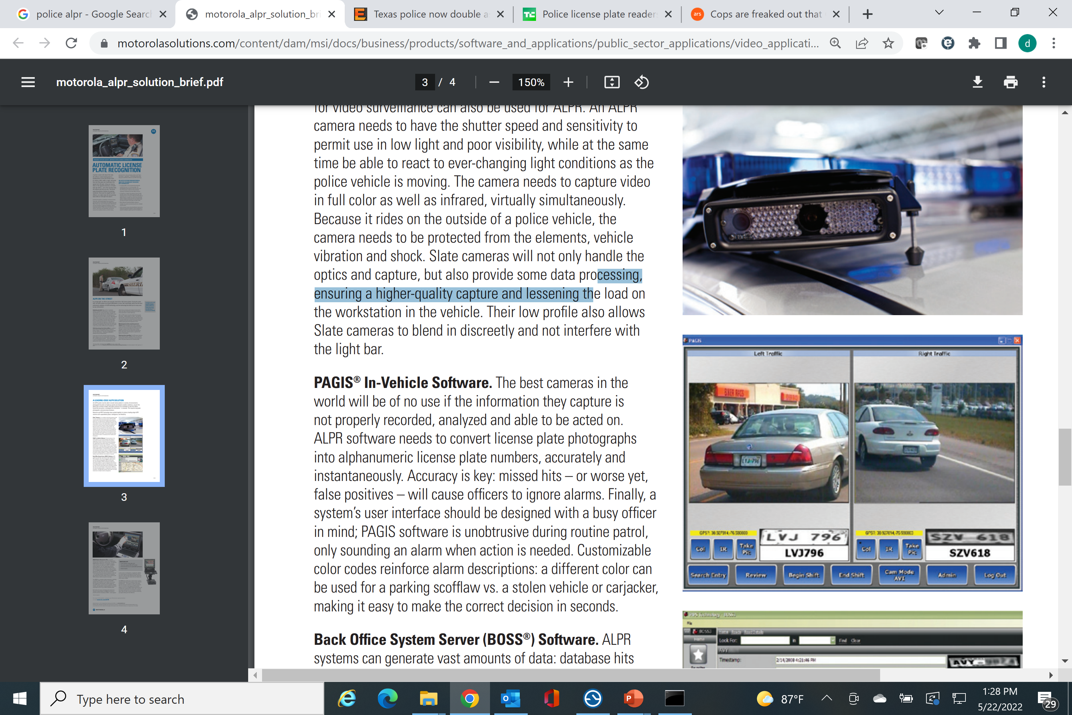
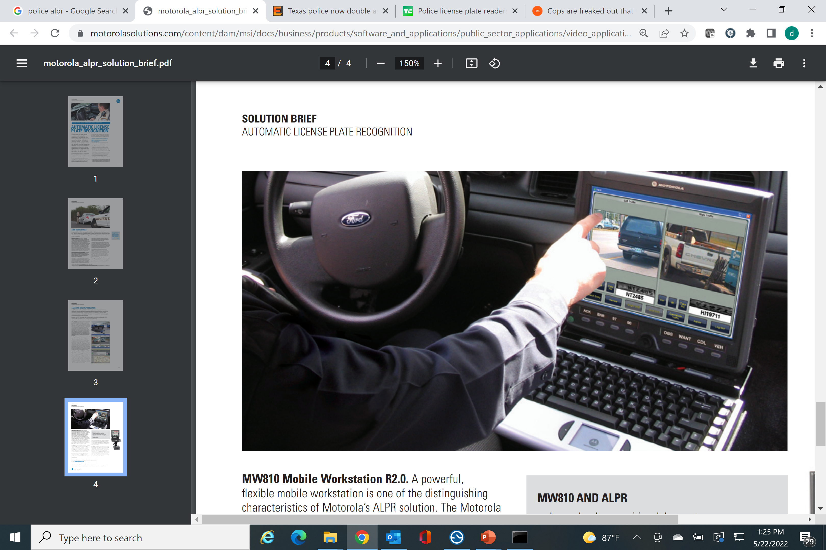
Project Overview
Automatic License Plate Recognition System - ALPR

Slide 4
Project Overview
Architect an automatic license plate recognition system with a UI for use within a moving vehicle.
Ensure the best possible performance; minimize latency, and maximizing recognition accuracy, image quality and frame rate
System shall be robust with automated fault detection and recovery
Ensure all network communication is secure
Computer system within the vehicle will communicate with a remote backend server to obtain vehicle information
You are responsible for architecting and designing the entire system in the vehicle and the remote backend database
Assume 5G networking to the backend database

Slide 5
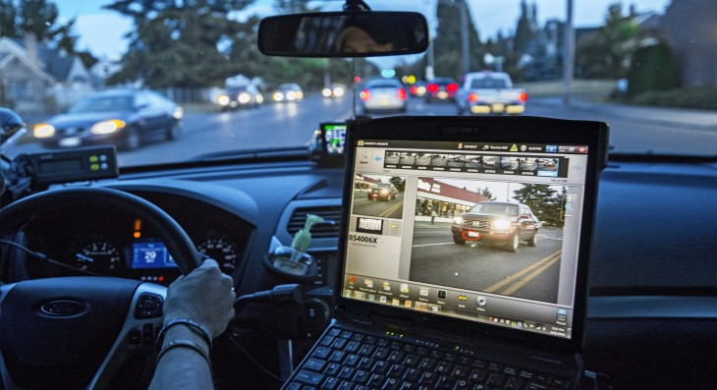

Project Description – 1
Backend License Plate Server
5G
TCP/UDP
TCP/UDP
UI and ALPR vehicle control
and recognition system
License Plate Number
Status - Owner Wanted / Stolen / Unpaid Fines – Tow / No Wants/Warrants
Registration Expiration
Owner Name
Owner Date of Birth
Owner Street Address / Location
Owner City, State and Zip Code
Vehicle Year of Manufacture
Vehicle Make
Vehicle Model
Vehicle Color

Slide 6
Project Description – 2
Project Responsibilities
Ensure the best possible performance; minimize server latency, maximize recognition accuracy, image quality and frame rate.
Measure and display performance frame rate, frame size, jitter, latency.
Implementing the specified enhancements to the applications.
Proper fault/error detection, recovery, and reporting.
Ensure application network communication is secure

Slide 7
Project Description – 3
The user display and system control application is responsible for the following:
Login and authenticate user locally and to the backend license plate database lookup system.
Provide secure communication between the laptop application and to the backend license plate database lookup system.
Read images from a playback file and identify license plates for evaluation.
Perform the ALPR function in real-time while maintaining a frame rate of at least 25fps.
Query the backend license plate server for details about the vehicle. The user must be alerted for vehicles that are stolen, the owner is wanted (criminal), or if it is a vehicle of interest (expired registration, unpaid tickets, owner is missing). Alerts must contain reason, owner name, address, and vehicle make, model and color along with the isolated plate image and the recognized license plate number for operator comparison.
If a license plate does not generate an alert, then the UI must display the last recognized plate image, the recognized license plate number and vehicle make, model and color so the operator can visually check if the plate matches the vehicle if desired.

Slide 8
Project Description – 4
An area in the UI that contains the playback view at all times.
The UI shall display the computed camera / playback frames per second, average time per frame, jitter and frame number.
The ability to detect network connectivity issues with the backend server within 5 seconds and automatically resolve the communication issue if possible.
Alert operator of any communication errors or failures.
The server application shall provide the following functionality :
Provide license plate queries
Ensure secure communication with the laptop applications
Authenticate remote laptop users
Support multiple users
Return the best match license plate if there is not an exact match that includes a configurable minimum confidence threshold to support a partial match.
Track the average number of queries per second for each user and overall queries per second, for all users.
Track the number partial matches and no matches for each user and all users
Support configurable values via a configuration file.

Slide 9
Project Description – 5
System Software
Windows OS 10 running on a (Laptop)
Microsoft Visual Studio Community 2022 Addition (download from Microsoft)
Python version Python 3.10.4
OpenALPR (built from source)
OpenCV (source available)
Berkeley DB (built from source)
Tesseract (built from source)
Liblept (built from source)
Zlib (built from source)
Libjpeg (built from source)
Giflib (built from source)
Libpng (built from source)
LibTiff(built from source)

Slide 10
Project Description – 6
Sample/Demo Code
Sample UI and ALPR vehicle control and recognition system (lgdemo.exe)
Sample backend database server (server.exe)
Sample database data generator using faker (rungen.bat)
Sample Database loader (loaddb.exe)

Slide 11
Project Description – 7
You may use your laptops to assume various roles in your system in anyway you like
You must you a separate laptop for the UI and ALPR vehicle control and recognition system and the backend database. The backend database must be communicated with via your network
You may use 3rd party, open-source SW, but please check with the owner (course instructor).

Slide 12
Project Prerequisites - 1
Install Python (https://www.python.org/ftp/python/3.10.4/python-3.10.4-amd64.exe)
Install pip (https://www.geeksforgeeks.org/how-to-install-pip-on-windows/)
Install Faker (https://faker.readthedocs.io/en/master/)
Install Microsoft Visual Studio Community Edition 2022 https://visualstudio.microsoft.com/downloads/
You will need C++ language support
You can use this configuration file to ensure all needed components are installed ->

Slide 13
Project Prerequisites - 2
Download the following files from Canvas
LG_MVS20222.vsconfig
OpenAPLR-3.1.1_Vs2022.zip
beaver1.avi
beaver2.avi
Unzip OpenAPLR-3.1.1_Vs2022.zip
Load OpenALPR Solution into Visual Studio
Set solution to release
Build Solution
Ensure 15 projects build successfully

Slide 14
Contact info
Daniel Plakosh - dplakosh@sei.cmu.edu

